Slide 1
Event Shunting and Event Storming
(what PAL had only just barely covered)

Slide 2
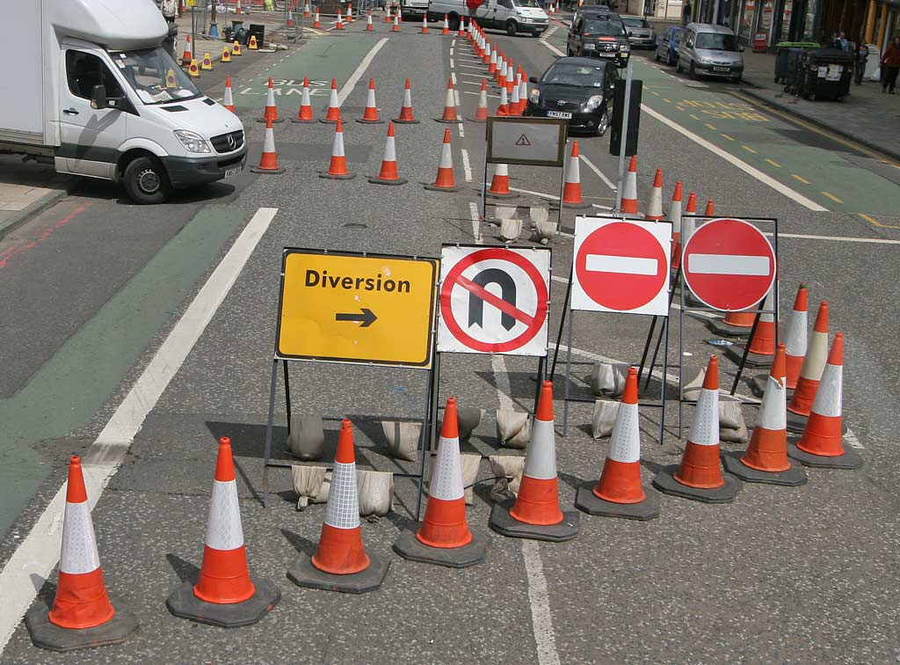
Event Shunting
Shunt (UK) aka Switch (US)
Shunt is temporary solution which replaces a de-commissioned ‘monolith’ and emits relevant messages using legacy format.
Allows to replace one legacy application at a time without disrupting an entire ecosystem
Easy to write
Shunts are removed when they are no longer needed – “like picking up traffic diversion cones when the construction is done”

Slide 3
Event Storming
Domain Event: asynchronous transactional message
Martin Fowler defined “Domain Event” in 2005
Alberto Brandolini first described Event Storming in 2013
Lightweight and low-cost method for business process modeling and requirements engineering
Domain experts + engineers (6-8 people) meet for 1-2 hours discovering domain events
Using any open space + color-coded sticky notes to document the findings.
Command (Action)
Aggregate: “a cluster of associated objects that
we treat as a unit for the purpose of data changes”
Problem (hotspot)
Consequences

Slide 4
Event Storming is Useful Because…
User
Domain events
Signed in
Bounded contexts
Signed out
Helps design cohesive microservices by virtue of determining events in their respective subdomains
Facilitates estimations – both by coverage and level of details
Promotes common (‘ubiquitous’) language (out of scope for this session) to effectively communicate at all levels.
Leads to a more responsive system
Helps create set of acceptance tests
Address
Changed
Cart
Item
Added
Order
Order
Submitted
EOD
(timer)
Item
Removed
Notes:
Lack of communication is always someone ELSE’s fault. Event Storming allows EVERYONE an opportunity to be good communicators
high level of details leads to better estimates
“Create a simple table with estimation units for each component type that you will need to implement. This will take the guesswork out of estimates and provide science around the process of creating estimations of effort.” – from “Managing DDD on an Agile Project”

Slide 5
How Does it Work?
Aggregate
Command
“First and primary focus on the business process, not on the data and its structure”
“More events is better than fewer events, because that’s what will make you learn”
“Make [Event Storming] sessions fun and efficient (gamify - ?)
“[…]no one is going to resist the opportunity to refine due to effort already invested”
Domain
Event
Time
Notes:
Identify Events
Define Commands and affected Aggregates
Draw boundaries

Slide 6
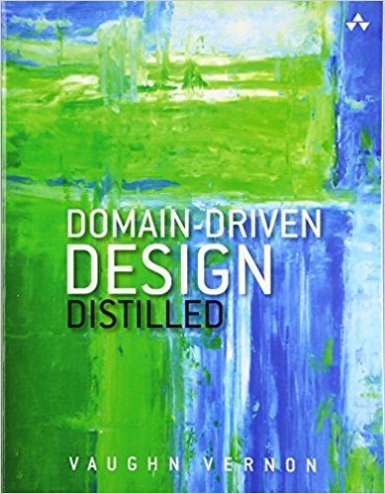
Disclaimer + References
Based on my Kindle highlights from https://www.amazon.com/Domain-Driven-Design-Distilled-Vaughn-Vernon/dp/0134434420
Graphics are my own.
Links:
Migrating Apps to the Cloud — Shunting the Event Stream
https://leanpub.com/introducing_eventstorming
https://docs.microsoft.com/en-us/dotnet/standard/microservices-architecture/architect-microservice-container-applications/data-sovereignty-per-microservice
Modeling Aggregates with DDD and Entity Framework

